Slide 1
Chapter 13
Abstract Classes & Methods
Sections 13.1-13.4

Slide 2
Objectives
    To design and use abstract classes (§13.2).
    To generalize numeric wrapper classes, BigInteger, and BigDecimal using the abstract Number class (§13.3).
    To process a calendar using the Calendar and GregorianCalendar classes (§13.4).

Slide 3
Inheritance & Polymorphism Recap
Let’s consider the three classes that we discussed in the Chapter dealing with Inheritance and Polymorphism.

Slide 4

Inheritance & Polymorphism Recap
GeometricObject
CircleFromSimpleGeometricObject
RectangleFromSimpleGeometricObject
TestCircleRectangle
Run

Slide 5
Inheritance & Polymorphism Recap
Can I write a method as follows which takes an object of type Geometric Object and displays its area and perimeter?
public static void displayGeometricObject(GeometricObject object) {
System.out.println("The area is " + object.getArea());
System.out.println("The perimeter is " + object.getPerimeter());
}

Slide 6
Inheritance & Polymorphism Recap
We will get an error because at compile time, the compiler looks for the getArea() and getPerimeter() methods in the GeometricObject class (static binding). And the methods don’t exist there.
public static void displayGeometricObject(GeometricObject object) {
System.out.println("The area is " + object.getArea());
System.out.println("The perimeter is " + object.getPerimeter());
}

Slide 7
Inheritance & Polymorphism Recap
How do we solve the problem?
Well, we could have the two methods defined in the GeometricObject class.
But what would the methods return?
These methods cannot be implemented in the ­GeometricObject class because their implementation depends on the specific type of ­geometric object.

Slide 8
Abstract Methods
We need a way to declare the two methods in the GeometricObject class without defining them …. which brings us to the concept of abstract methods.
Abstract methods are declared using the abstract modifier in the method header, ends with a semi-colon and have no implementation (method body).
public abstract double getArea();
public abstract double getPerimeter();

Slide 9
Abstract classes
A class that contains an abstract method must be an abstract class.
Abstract classes are denoted using the abstract modifier in the class header.
For instance: public abstract class GeometricObject
An abstract class cannot be used to create objects.
The abstract methods from an abstract class are implemented in concrete subclasses.

Slide 10
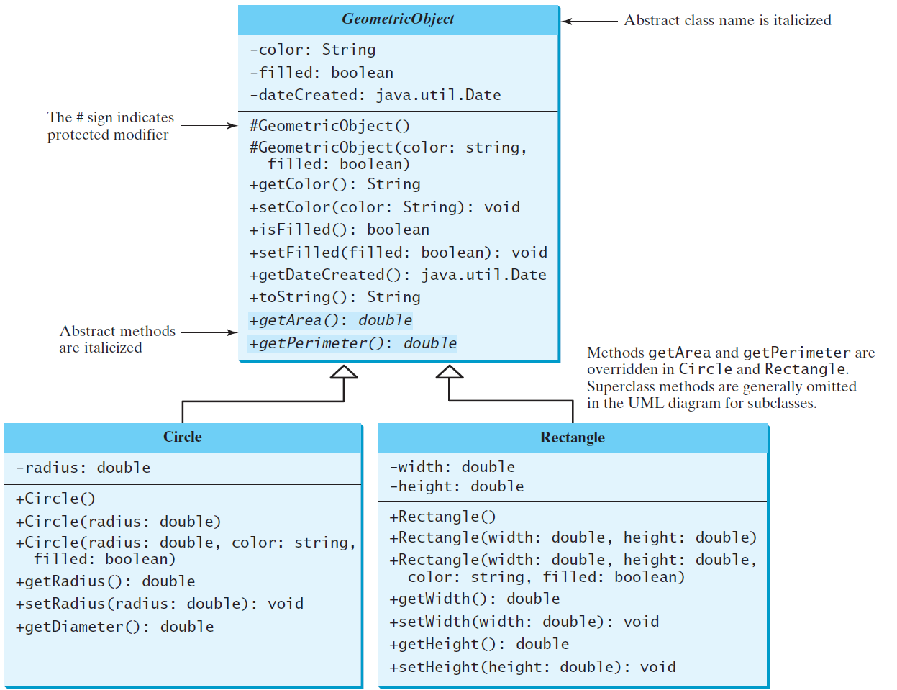
Abstract Classes and Abstract Methods
GeometricObject
Circle
Rectangle
TestGeometricObject
Run

Slide 11
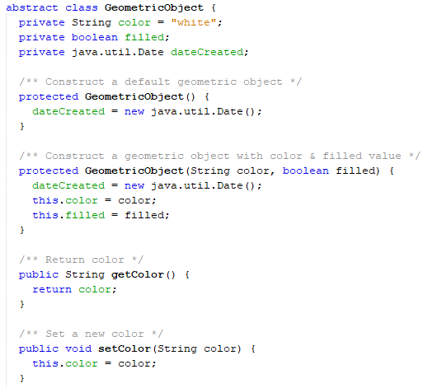
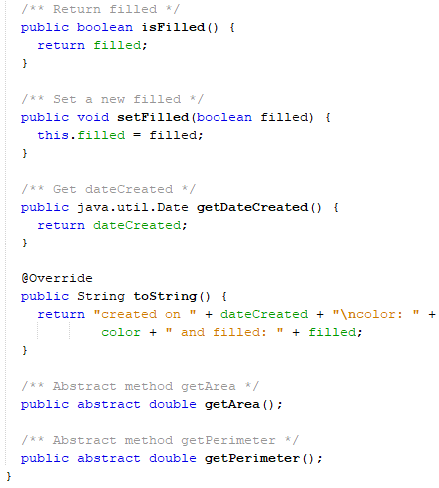
Abstract Classes and Abstract Methods

Slide 12
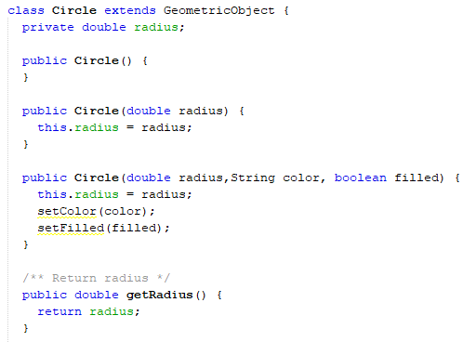
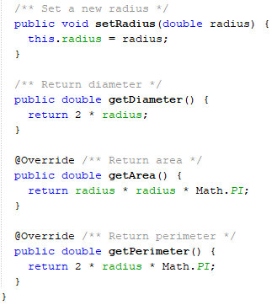
Abstract Classes and Abstract Methods

Slide 13
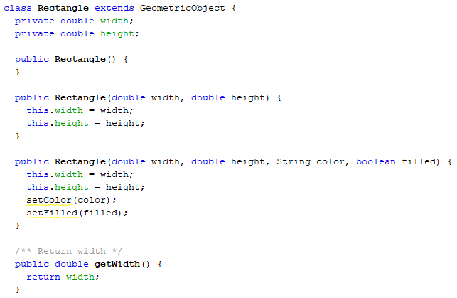
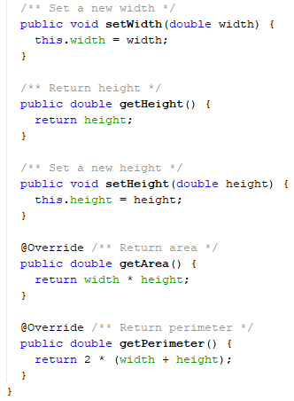
Abstract Classes and Abstract Methods

Slide 14
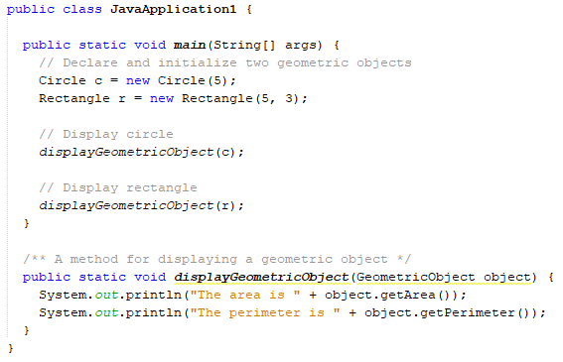
Abstract Classes and Abstract Methods

Slide 15
Points about Abstract Classes
An abstract method cannot be contained in a nonabstract class.
If a subclass of an abstract superclass does not implement all the abstract methods, the subclass must be defined abstract.
An abstract class cannot be instantiated using the new operator, but you can still define its constructors, which are invoked in the constructors of its subclasses. For instance, the constructors of GeometricObject are invoked in the Circle class and the Rectangle class.

Slide 16
Points about Abstract Classes
A class that contains abstract methods must be abstract. However, it is possible to define an abstract class that contains no abstract methods.
A subclass can be abstract even if its superclass is concrete. For example, the Object class is concrete, but its subclasses, such as GeometricObject, may be abstract.
A subclass can override a method from its superclass to define it abstract.

Slide 17
Points about Abstract Classes
You cannot create an instance from an abstract class using the new operator, but an abstract class can be used as a data type.
Therefore, the following is correct:
GeometricObject g = new Circle();

Slide 18
Exercise
What is wrong with the following class definition?
abstract class A {
protected void unfinished();
}

Slide 19
Exercise
Suppose A is an abstract class, B is a concrete subclass of A, and both A and B have a no-arg constructor. Which of the following is correct?
1. A a = new A();
2. A a = new B();
3. B b = new A();
4. B b = new B();

Slide 20
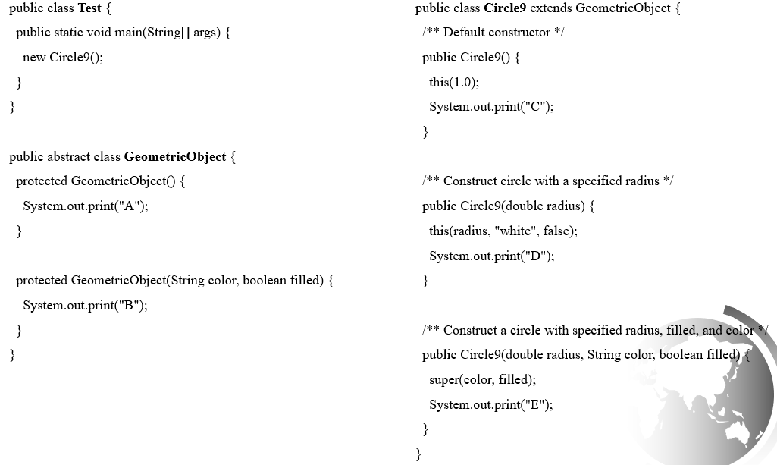
Exercise – What is the output?

Slide 21
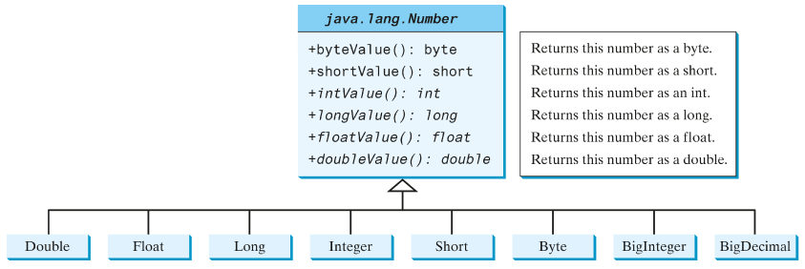
The Abstract Number Class
The Number class is an abstract superclass for Double, Float, Long, Integer, Short, Byte, ­BigInteger, and BigDecimal.
The common methods intValue(), longValue(), floatValue(), and doubleValue() from the subclasses are declared as abstract methods in the ­Number class.

Slide 22
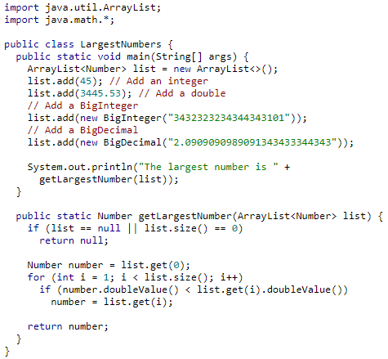
Case Study: the Abstract Number Class
LargestNumbers
Run

Slide 23
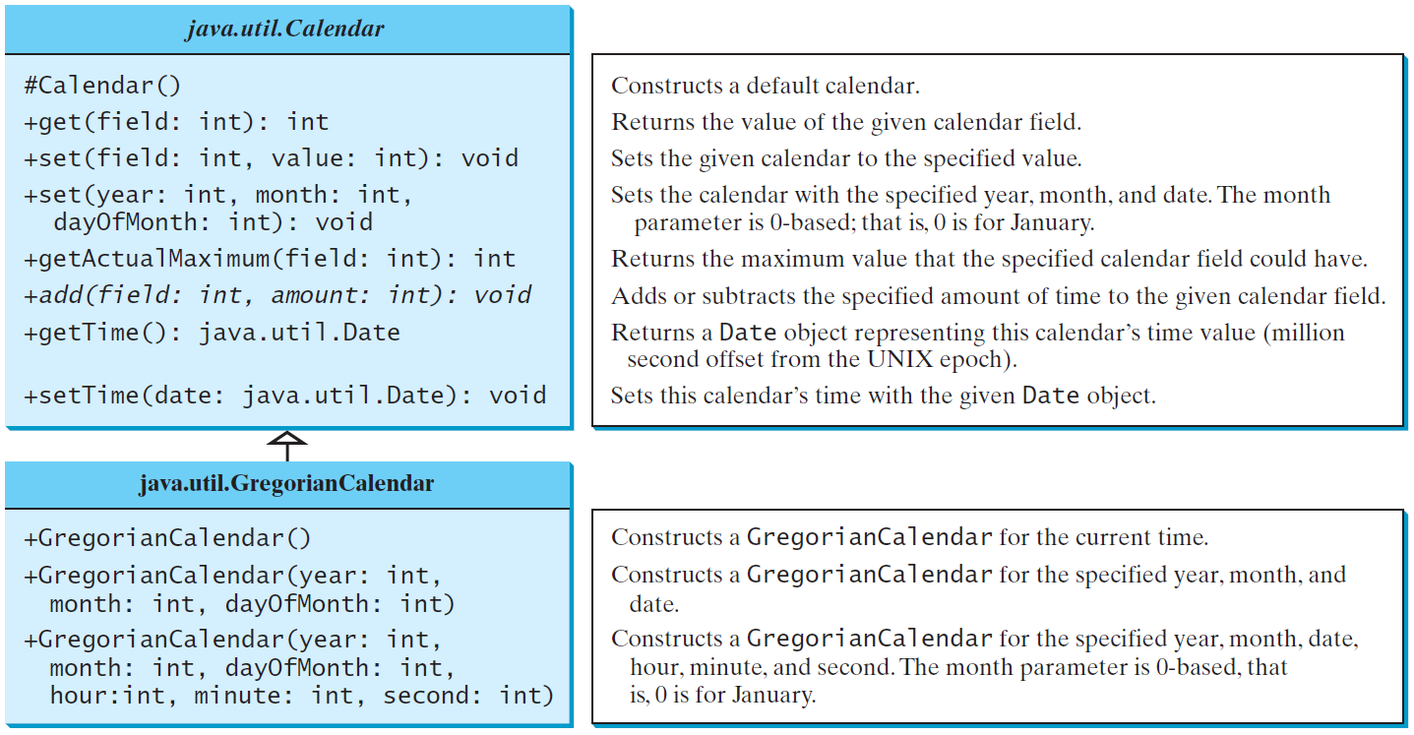
The Abstract Calendar Class and Its GregorianCalendar subclass
java.util.Calendar is an abstract base class for extracting detailed calendar information, such as the year, month, date, hour, minute, and second.
Subclasses of Calendar can implement specific calendar systems, such as the Gregorian calendar, the lunar calendar, and the Jewish calendar.
The add method is abstract in the Calendar class because its implementation is dependent on a concrete calendar system.

Slide 24
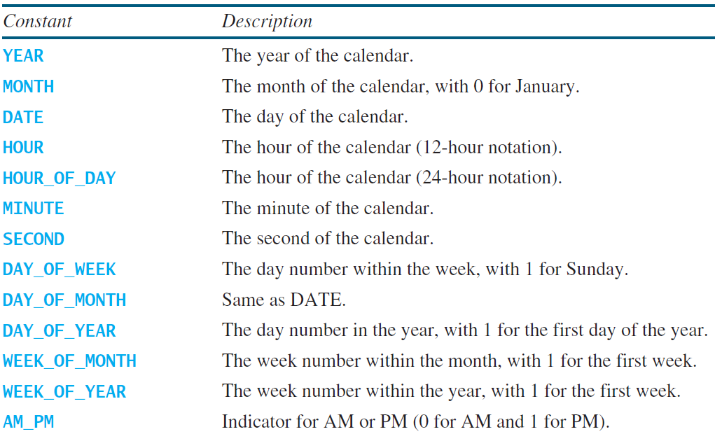
The get Method in Calendar Class
The get(int field) method defined in the Calendar class is useful to extract the date and time information from a Calendar object. The fields are defined as constants, as shown in the following.

Slide 25
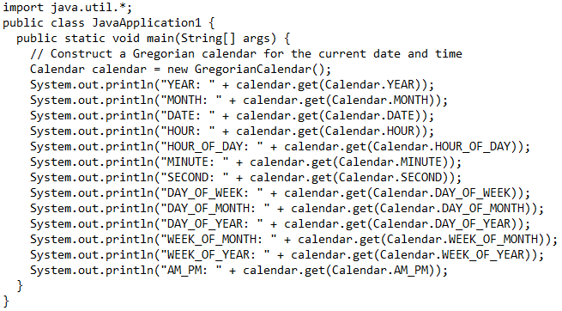
Getting Date/Time from Calendar
TestCalendar
Run

Slide 26
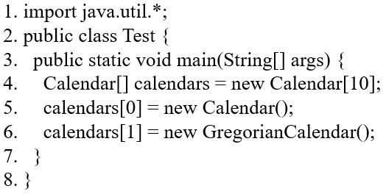
Exercise – Select the correct statement(s)
A. The program has a compile error on Line 4 because java.util.Calendar is an abstract class.
B. The program has a compile error on Line 5 because java.util.Calendar is an abstract class.
C. The program has a compile error on Line 6 because GregorianCalendar is an abstract class.
D. The program has no compile errors.

Slide 27
Exercise
(Triangle class)
Implement a Triangle class that extends the abstract GeometricObject class.
Write a test program that prompts the user to enter three sides of the triangle, a color, and a Boolean value to indicate if the triangle is filled. The program should create a Triangle object with these input values. The program should then display the area, perimeter, color, and filled values by calling appropriate methods.

